Slide 1
Responsible travel means less environmental impact
Most important aspects of travelling responsibly:
Reduce Environmental Impact
(8 out of 11 participants)
Reduce waste
(6 out of 11 participants)
“I aim to leave each and every place I visit cleaner than I found it”
– Richa, 23, full-time traveler

Slide 2
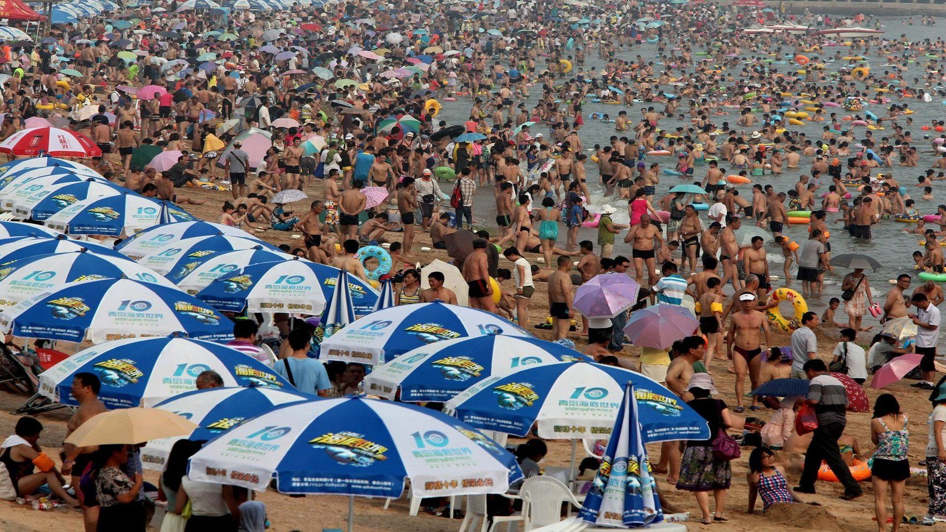
Mass tourism is perceived as an issue
A particularly strong pain point is mass tourism (9 out of 11 participants). Ways participants deal with it are:
Avoid too touristy places all together
Visit during off seasons
Favor places with visitor limits
“It’s sad to see wonders of nature or unique heritage architecture being damaged irrevocably by the sheer volume of people visiting.” – Mika, 35, long term traveler

Slide 3

Buttons are too far apart
5 out of 7 participants had trouble using the app as buttons are too far apart. They couldn’t use the app conveniently with one hand.
“It’s kind of difficult to use, as I can’t reach the buttons with my thumb.”
– Participant 4, Android version

Slide 4
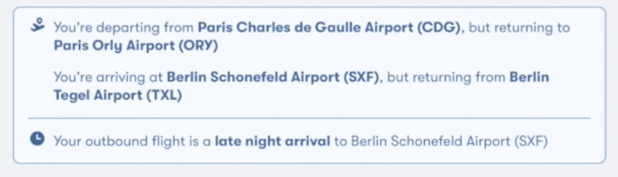
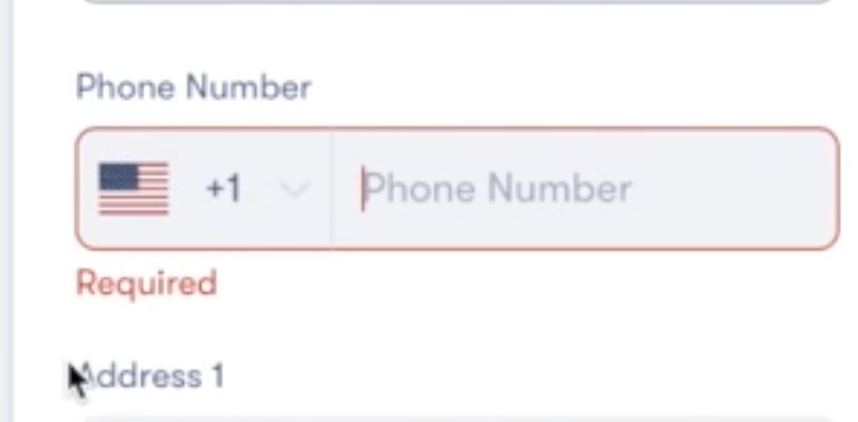
Travel booking journey
😃
Info about differing location of arrival is helpful.
“Can I enter my discount card somewhere?”
Checking mandatory fields first.
User experience
“I’d prefer a metric that compares travel duration and price.”
“Why is my phone number required?”
Page takes long to load
😠
Entering destination
Comparing options
Checkout

Slide 5
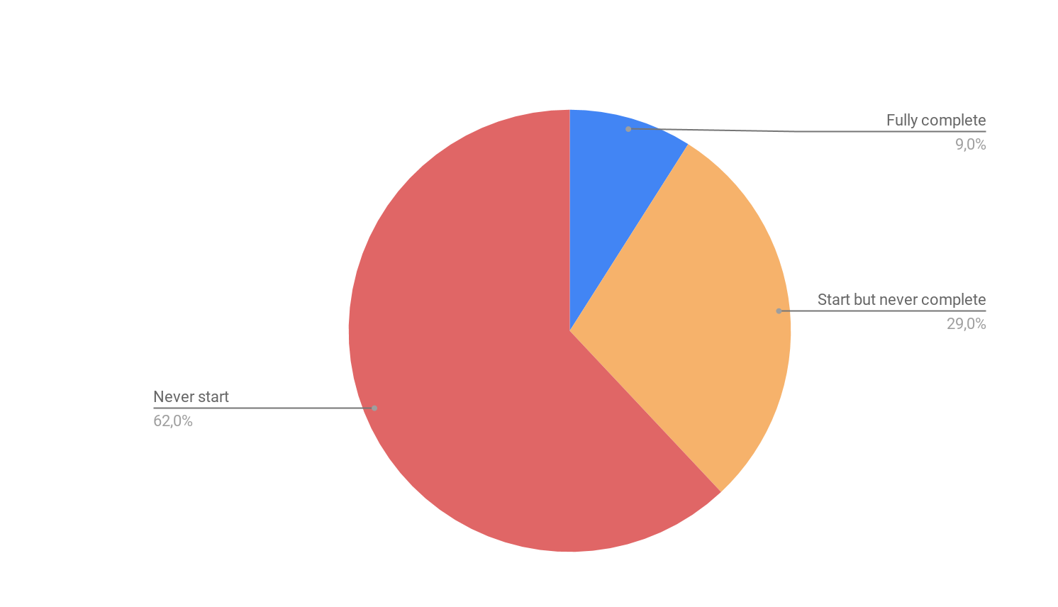
Users dismiss onboarding tour because it is too long
“I just wanted to check if it had this one feature; a tour seemed unnecessarily long.”
“After I learned what I needed I dismissed the tour.”
“I saw the offer for a tour, but it had 14 steps and I didn’t want to go through all of them.”
New users May-July, N=478
Data is from product analytics team

